Slide 1




Internet of Things (IoT) technology for hydrological measurements
Crash course at NMAIST Arusha, 11-12 March 2019
Resource persons: Douglas Nyolei and Jan Diels

Slide 2
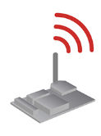
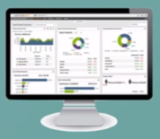
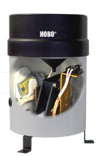
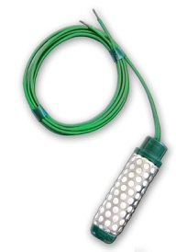
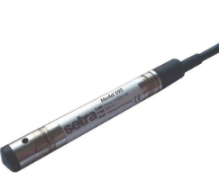
µcontroller with antenna
Sensors

Slide 3
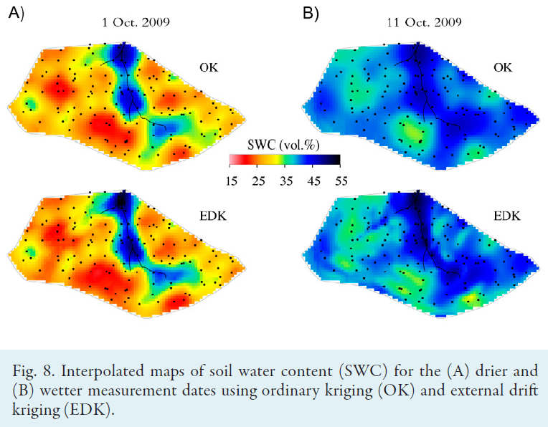
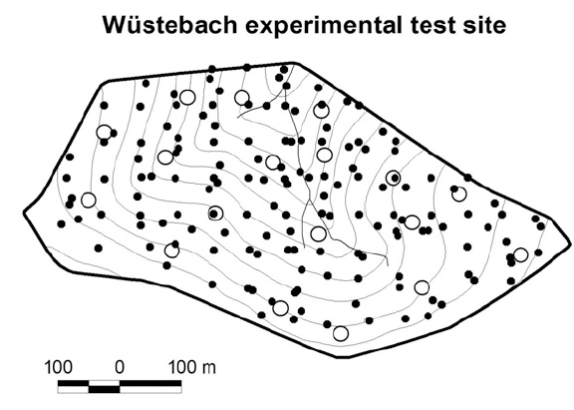
Inexpensive wireless sensor networks allow to measure at spatial scales that matter for hydrologists
Source: Bogena, H.R., Herbst, M., Huisman, J.A., Rosenbaum, U., Weuthen, A., Vereecken, H., 2010. Potential of Wireless Sensor Networks for Measuring Soil Water Content Variability. Vadose Zone Journal 9, 1002-1013.

Slide 4
Options for wireless communication
Protocols for Internet of Things (IoT)
Battery-operated devices with autonomy of months-years
that send only few measurements in a day
 | GSM | Wifi & Bluetooth | LoRaWAN & Sigfox
Range | <30 km | <20-50 m | 5-10 km
Energy consumption | High | High | Low
Frequency band | Licensed | License-free | License-free
Data speed | High | High | Low

Slide 5
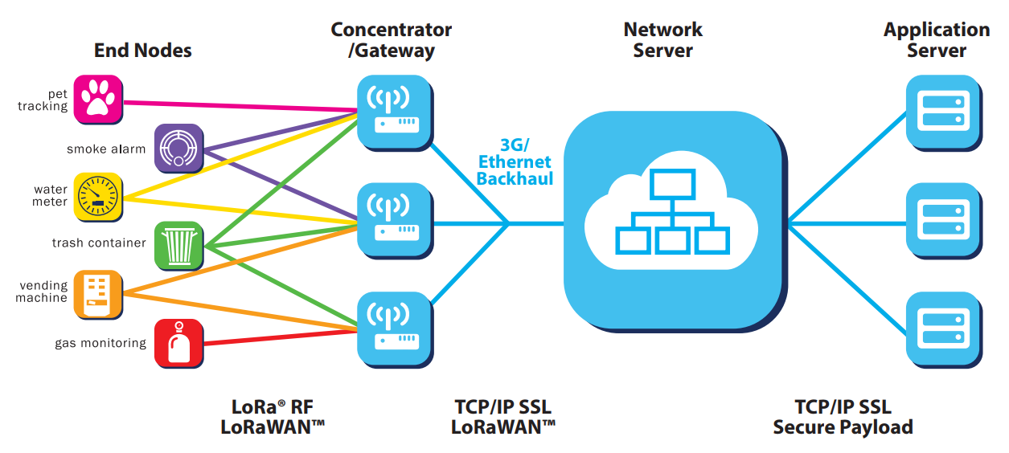
Source:
LoRa® and LoRaWAN™ Technical Marketing Workgroup 1.0, 2015. A technical overview of LoRa® and LoRaWAN™. https://lora-alliance.org

Slide 6
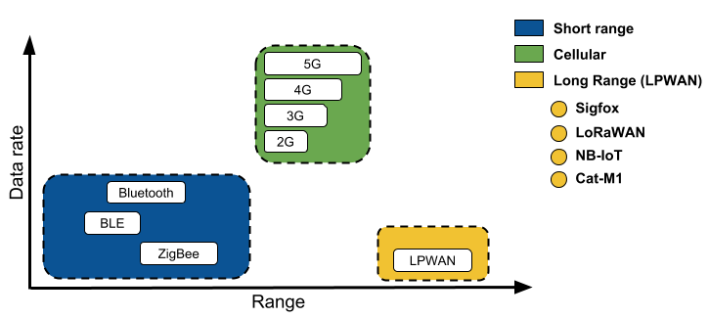
High power
(battery life 1-2 days)
Low power
(battery life months to years)
LPWAN =
low power wide area network
Urban: 1-5 km
Rural: 10-40 km
Source: Maria Hernandez (2018). Connectivity Now and Beyond; exploring Cat-M1, NB-IoT, and LPWAN Connections. https://ubidots.com/blog/exploring-cat-m1-nb-iot-lpwan-connections/

Slide 7


LoRaWAN = Long Range Wide Area Network = an open protocol for wireless data transmission for IoT
Sigfox = proprietary protocol for wireless data transmission for IoT as used by the French company Sigfox

Slide 8
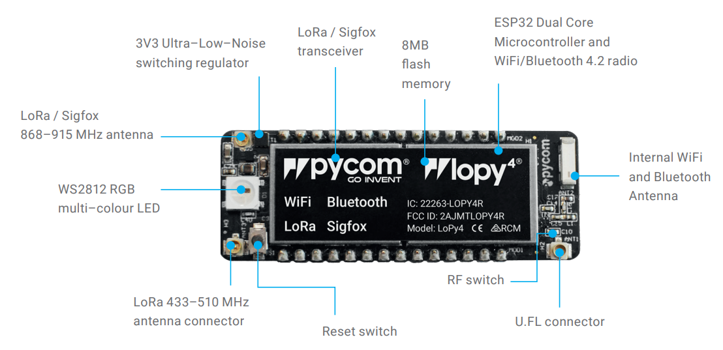
Source: Datasheet lopy4 at Pycom website

Slide 9
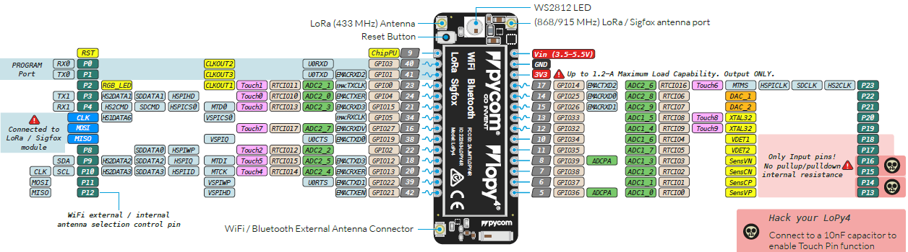
LoPy⁴ (pycom):
ESP32 dual core processor @ 160 MHz
Programmed in MicroPython
Bluetooth, Wifi, Sigfox, LoRaWAN
22µA in deepsleep mode (battery of 2000mAh will last for 10 years)
15mA when active and sending data (battery of 2000mAh will last for 2.2 years if device is active 10 minutes per day).
Notes:
32 bit. 10 times faster than Arduino that is 8 bit. My laptop is running at 2.7GHz, that is 17 times faster than LoPy; explain pins, ADC, DAC

Slide 10
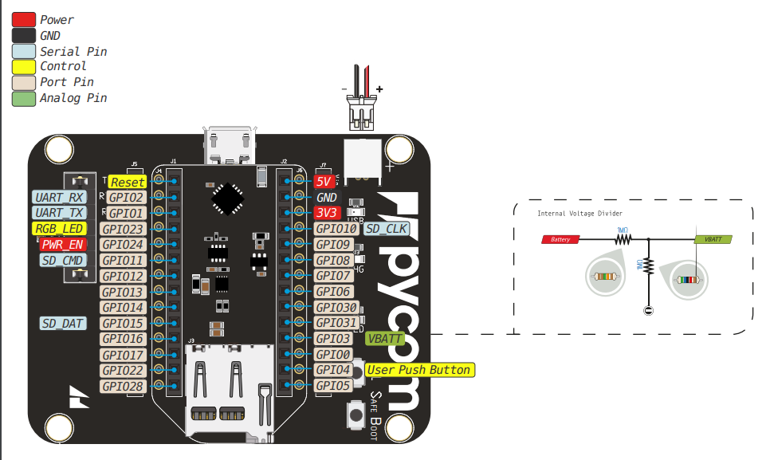
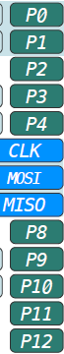
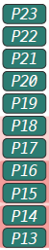
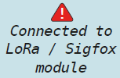
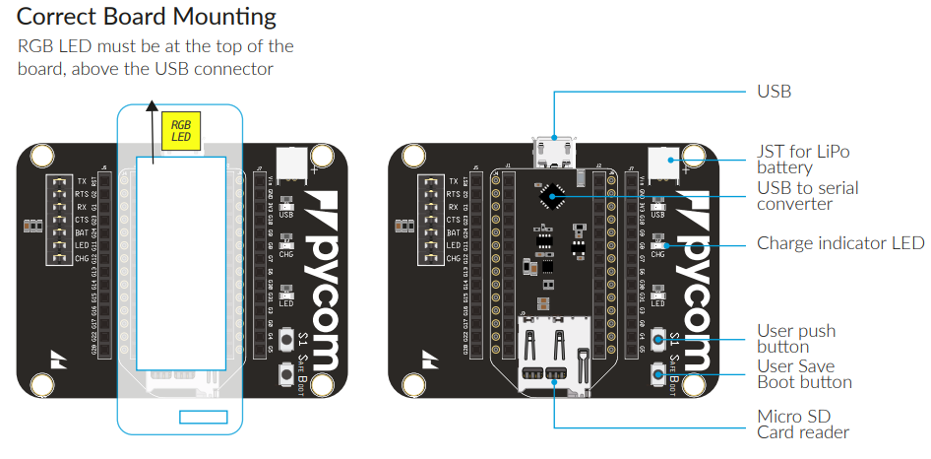
Pycom Expansion board V3.1
Pin numbers ‘P0’ to ‘P23’ written on lopy4 and on expansion board V3.1 are also used in python code. Do not confuse them with the G1- G17 numbers that are different!
(connected to P16)
P5 (CLK), P6 (MOSI), and P7 (MISO) normally should not be used as they are connected to the LoRa and Sigfox modules.
User LED connected to P9
(connected to P10)

Slide 11
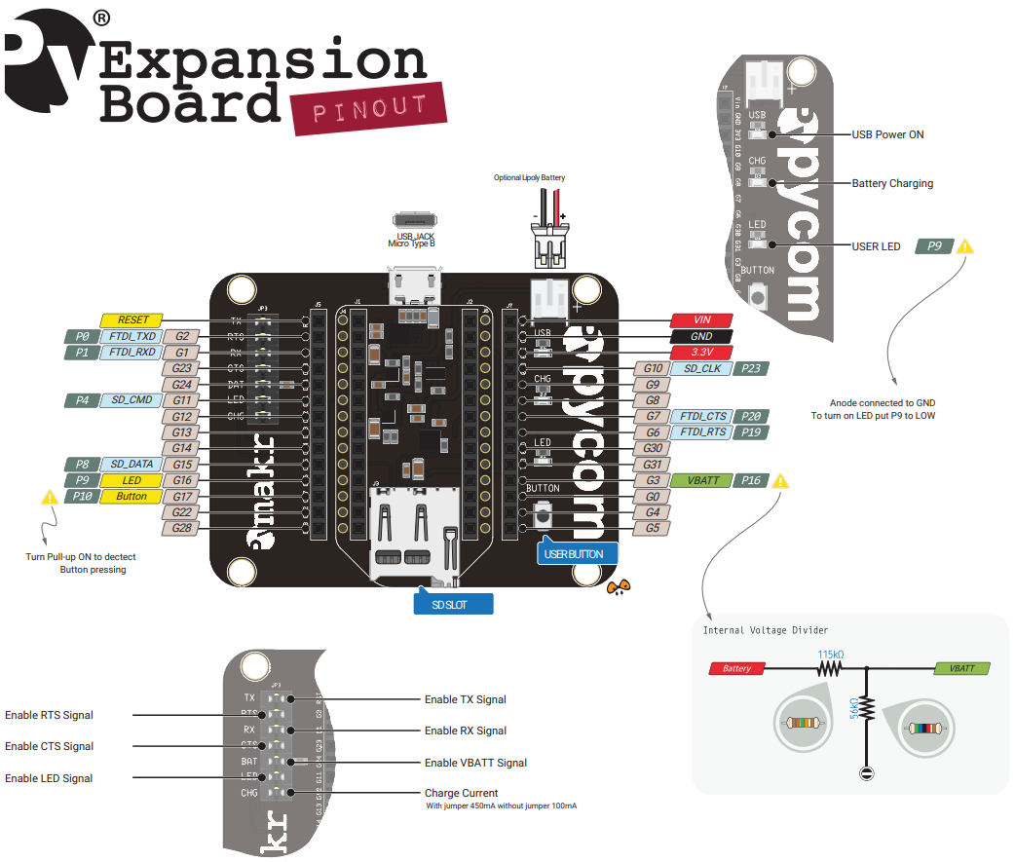
Notes:
The pinout of Expansion Board V2 is much clearer. And V3.1 is still like this, except that an extra save boot button was added.

Slide 13

MicroPython = a programming language derived from Python 3.5 that is optimised to run on micro controllers:
Upward compatible with Python 3.5 (but minor differences)
Has specific libraries for accessing hardware (pins, led, ADC, …)
Language reference: https://docs.micropython.org
Documentation of the MicroPyhon that is implemented by Pycom: https://docs.pycom.io

Slide 14


Atom: source code editor that we will use for programming the Pycom board: https://atom.io/
We install the Pymakr Extension (=plugin) in Atom
The Pymakr extension allows to:
Execute python commands on the Pycom boards
Edit MicroPython code
Upload code to the Pycom boards (via USB cable or via Wifi)
Instructions on how to install Pymakr: https://docs.pycom.io/pymakr/installation/atom.html

Slide 15
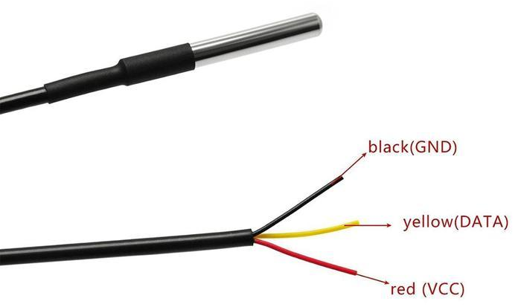
Reading the DS18B20 sensor with the on-wire protocol
How to connect to Lopy4
GND (=ground)
P10 or other pin (will be used for communicating with sensor)
+3.3V (=power to sensor)
Since each sensor can be addressed by a unique address, several sensors can be connected to the same data pin.

Slide 16
Reading the DS18B20 sensor with the on-wire protocol
Atom >> File >> Open folder >> \IoT course\DS18B20TemperatureSensor
Library provided by Pycom at:
https://github.com/pycom/pycom-libraries/tree/master/lib/onewire
Import libraries that come with firmware on lopy4
Import library from \lib\ folder in project
main.py:
\lib\onwire.py:

Slide 17
Reading the DS18B20 sensor with the on-wire protocol
Open folder \IoT course\DS18B20TemperatureSensor in Atom
demo.py in folder \IoT course\DS18B20TemperatureSensor:
Open demo.py in atom and click on ‘run’ in pymakr window to run the demo file
Or copy and issue commands in command window
See https://docs.pycom.io/tutorials/all/owd.html

Slide 18
Reading the DS18B20 sensor with the on-wire protocol
Task 4: Now warm up the sensor with you hand and observe how quickly the sensor reacts to this (repeatedly run demo.py)
Open folder \IoT course\DS18B20TemperatureSensor in Atom, and next click ‘upload’ from the pymakr console. This will assure that the onwire.py library is available on the lopy4.
Next open demo.py in atom and click on ‘run’ in pymakr window to run the demo file.
Or copy and issue commands in command window

Slide 19
Reading the DS18B20 sensor with the on-wire protocol
main_new.py in folder \IoT course\DS18B20TemperatureSensor
v
Indentation determines the grouping of statements in python
v
v
v
v
v
v

Slide 20
Reading the DS18B20 sensor with the on-wire protocol
main_new.py in folder \IoT course\DS18B20TemperatureSensor
Function arguments
Function definition
Return to the programme that called the function, and pass result (TempCelsius)
Function call
Function arguments passed from main programme to function
Another function call

Slide 21
Reading the DS18B20 sensor with the on-wire protocol
main.py in folder \IoT course\DS18B20TemperatureSensor
8-bit address in hexadecimal notation
ROM address of DS18XB20 = b'28aab10d1b13021c'
ROM address of DS18XB20 = b'28aac4b81a130218'

Slide 22
Reading the DS18B20 sensor with the on-wire protocol
Task 5: For this task you need two DS18X20 sensors: work with neighbour
Connect the two sensors to exactly the same pins on the lopy4: red to +3.3V, black to GND, and yellow to P10.
Use the white breadboard and jumper cables to do this.
Next run main.py and observe the temperature reading.
Are the two sensors giving the same temperature? Check if the readings react to warming them with your hands (one by one).

Slide 23
Use of the analog-digital converter (ADC) on the LoPy4 to measure voltage
ADC
(=Analog Digital Converter)
Analog signal
12-bit
12-bit
Number
(Integer between 0 and (2¹²-1)=4095
>>> A 12-bit ADC has a higher precision than a 10-bit ADC
Rescaling in Python code
Voltage

Slide 24
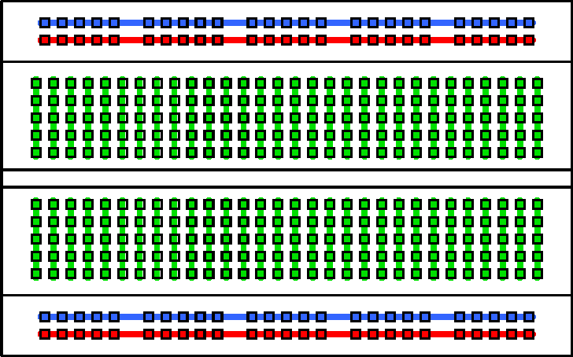
Breadboard wiring:

Slide 25
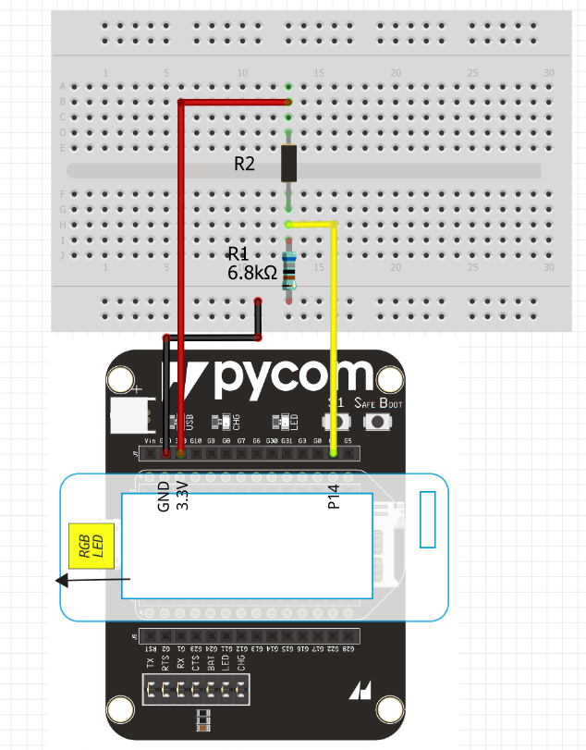
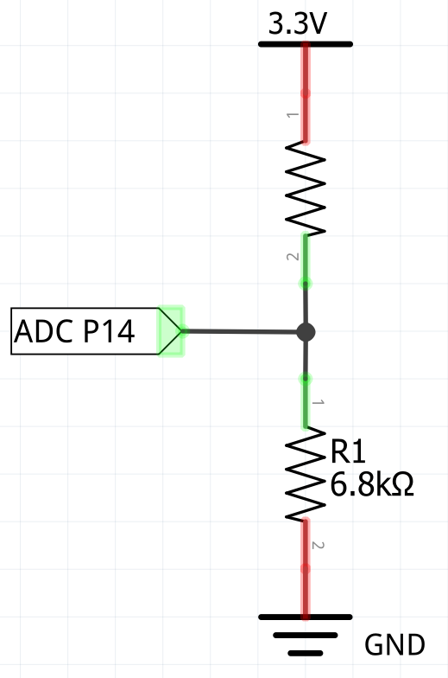
Use of the analog-digital converter (ADC) on the LoPy4 to measure voltage
R2
?? kΩ

Slide 26
Use of the analog-digital converter (ADC) on the LoPy4 to measure voltage
main.py in folder \IoT course\ReadVoltage

Slide 27
Use of the analog-digital converter (ADC) on the LoPy4 to measure voltage
Task 6:
Create a voltage divider with the resistor of 6.8kΩ and the resistor of unknown value put in series on the breadboard. Wire everything with jumper cables to the expansion board with the lopy4 (see 2 slides back)
Next run main.py (in folder \IoT course\ReadVoltage) and observe the voltage reading, and compare it with a voltage measurement with a multimeter.
Check what happens if you set nSamples to 10 instead of 10000

Slide 28
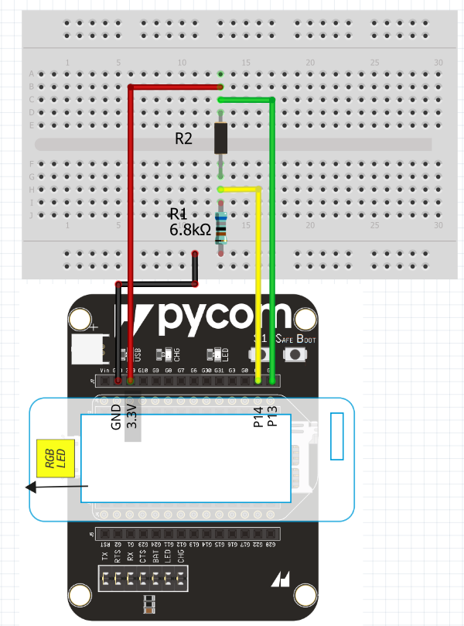
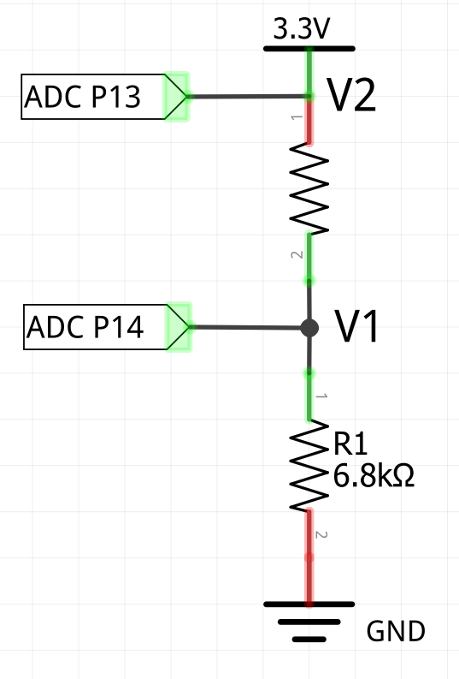
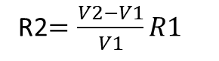
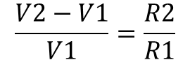
Use of the analog-digital converter (ADC) on the LoPy4 to measure resistance
$$\frac{V2−V1}{V1}=\frac{R2}{R1}$$
R2
?? kΩ
R2$=\frac{V2−V1}{V1}R1$

Slide 29
Use of the analog-digital converter (ADC) on the LoPy4 to measure resistance
Task 7:
Now also add the green jumper cable (to P13) as shown in the previous slide)
Modify the script main.py (in folder \IoT course\ReadVoltage) to measure the two voltages (V1 and V2), and to calculate and print the value of the unknown resistance

Slide 30
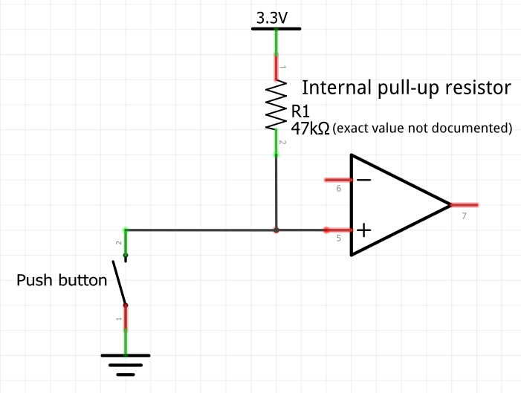
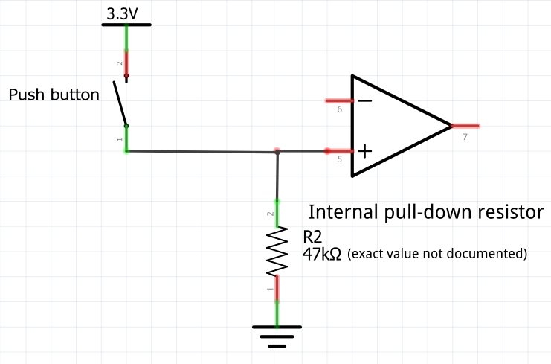
Action when button is pressed and interrupt calls
User push button S1 on expansion board is like this
Input pin
Input pin
Button released
Button released
Button released
Button released
Button pressed
Button pressed

Slide 31
Notes:
The pinout of Expansion Board V2 is much clearer. And V3.1 is still like this, except that an extra save boot button was added.

Slide 32
Action when button is pressed and interrupt calls
main.py in folder \IoT course\PushButton&LedExpansionBoard:
P9 defined as output pin (>>> LED)
P10 defined as input pin (<<< button)
Define what action is needed when interrupt is called
Trigger interrupt on pin ‘button’
Button released
Button released
Button pressed

Slide 33
Action when button is pressed and interrupt calls
Task 8:
Run main.py in folder \IoT course\PushButton&LedExpansionBoard and observe what happens when you push user button ‘S1’
What changes are needed in the code if we want to implement the configuration with the internal pull-down resistor (right hand 3 slides back)? No need to also implement the changes.

Slide 34
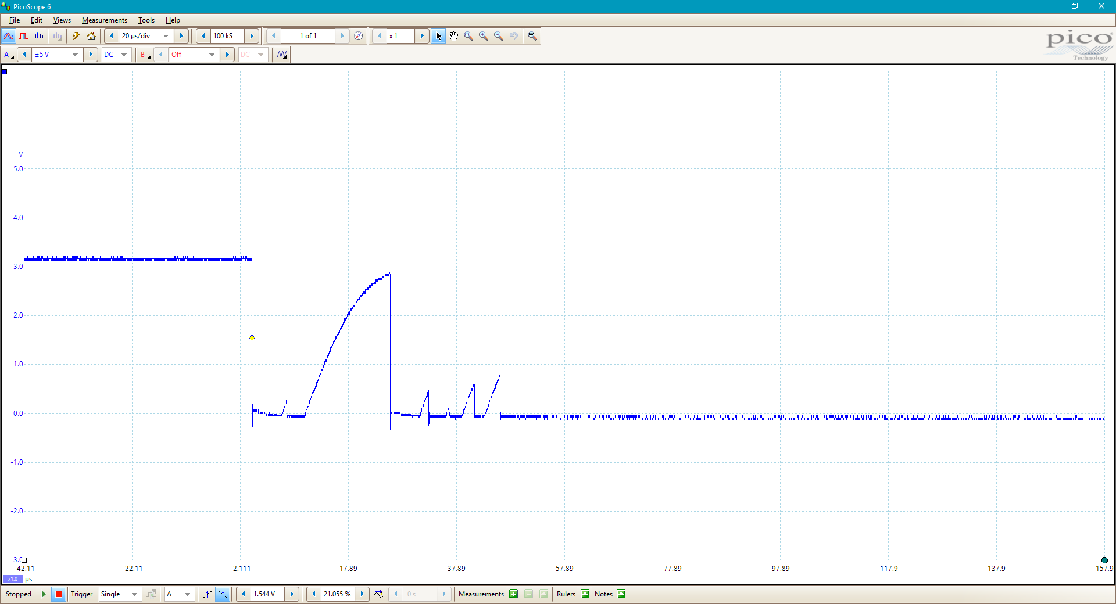
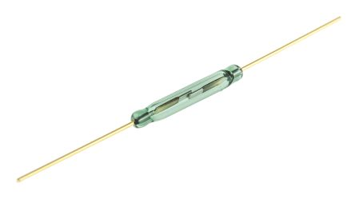
100 µs debounce time
Reed switch in tipping bucker raingauge

Slide 35
Keeping time and deepsleep
Lopy4 (and all microprocessors and computers) have a Real Time Clock (RTC) that keeps time
The Real Time Clock can be accessed through the machine.TRC() function as follows:
Lopy4 does not have backup battery for RTC. When powered up, the RTC is set to beginning of 1 January 1970 (‘Unix time’)

Slide 36
Keeping time and deepsleep
main.py in folder \IoT course\Deepsleep:

Slide 37
Keeping time and deepsleep
Task 9:
Run main.py in folder \IoT course\Deepsleep and observe what happens
Observe what happens when you push user button ‘S1’ during deepsleep.
In order to properly set the time you need to interrupt the script by repeatedly pressing CTRL+C while the programme is active (blinking led). This does not work during deepsleep (but you can use the reset button on the lopy4 to get it out of deepsleep)
Once you have stopped the script and you get the command prompt, you need to set the time with the command: rtc.init((2019, 3, 11, 15, 39)) (year, month, hours, minutes, seconds)
Now restart the programme by clicking on the ‘run’ menu button (upper right of Pymakr window in Atom). Check if the time is restored after deepsleep.

Slide 38
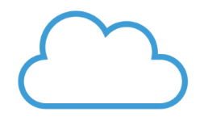
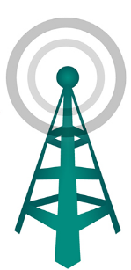
Sending data: How does it work?
Infrastructure of LoRaWAN or Sigfox provider
Backend server of your choice
User specifies to where data are transfered and how
Data storage, processing, graphs
Internet connection
Antenna
(gateway)
Your computer
Your sensor devices

Slide 39

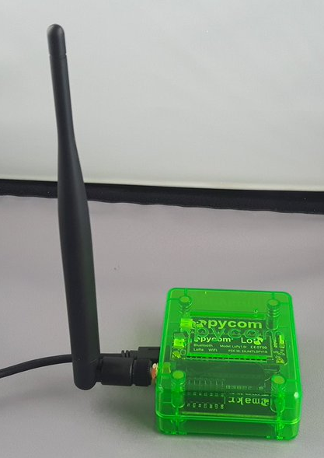
Can we do it without provider? Yes with LoRaWAN
Backend server of your choice
Antenna
(gateway)
Data storage, processing, graphs
Antenna network is built by you - the people
Nano gateway with lopy4
Your computer
Your sensor devices

Slide 40
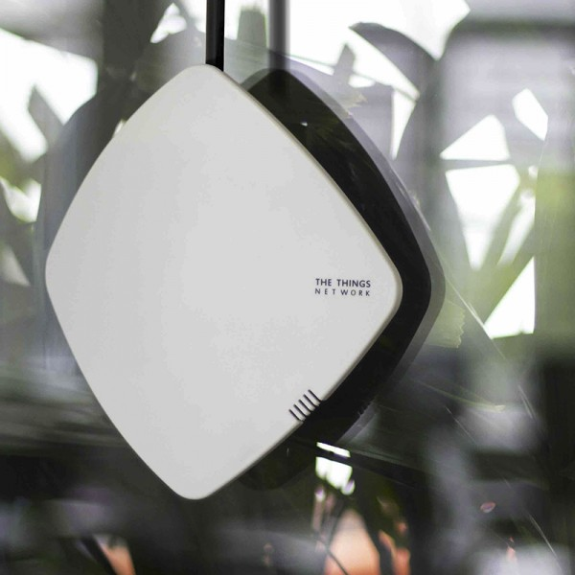
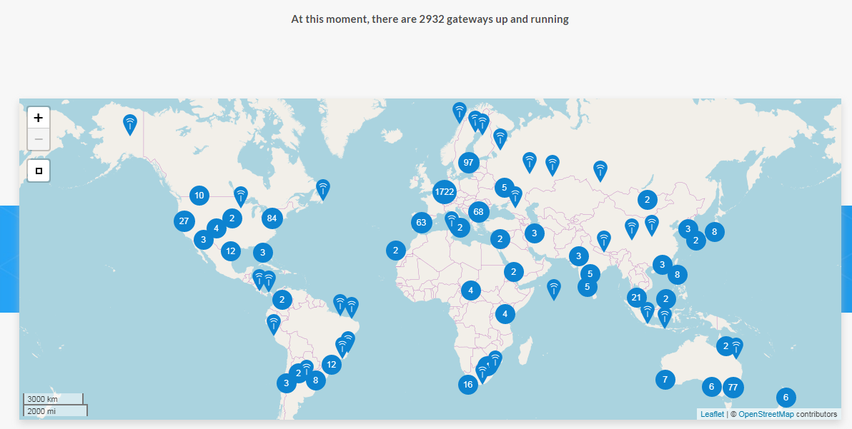
A gateway (=antenna) can reach sensors up to 10km away
280€
www.thethingsnetwork.org

Slide 41




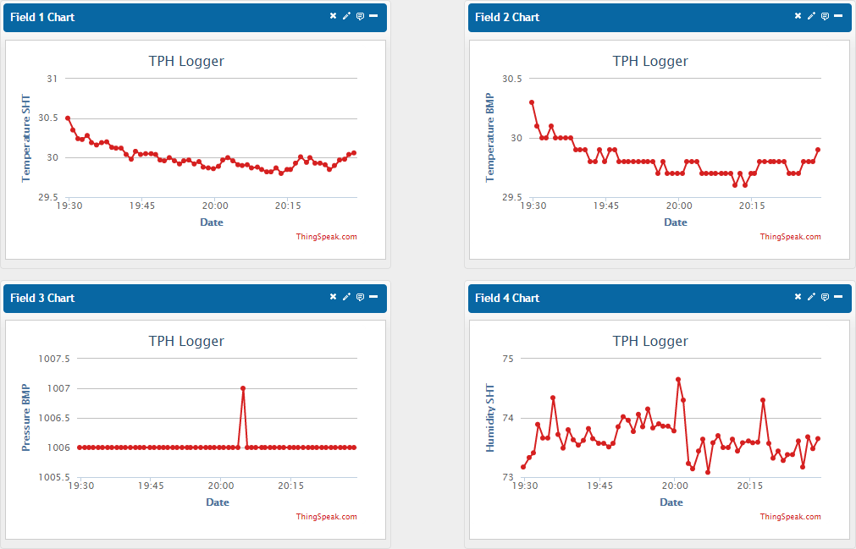
Data communication we will use:
Cloud services
HTTP via internet
LoRaWAN
Nano gateway with lopy4
HTTP via internet
Your lopy4
To reformat the data for ThingSpeak
Visualization, quality control, storage, analysis

Slide 42
Registering your lopy4 as a device on The Things Network (TTN)
Step 1: get the (unique) DevEUI from your lopy4
Open folder \IoT course\SendLora2TTN_abp in Atom (and close other folders):
findLoRaDeviceEUI.py in folder \IoT course\SendLora2TTN_abp:
Make ‘findLoRaDeviceEUI.py’ the active window in Atom, next click on ‘Run’ in the Pymakr menu:

Slide 43
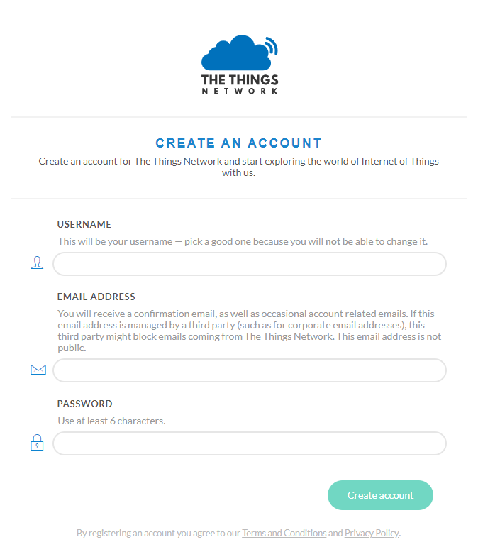
Registering your lopy4 as a device on The Things Network (TTN)
Step 2: Register yourself as user on The Things Network
https://account.thethingsnetwork.org/register

Slide 44
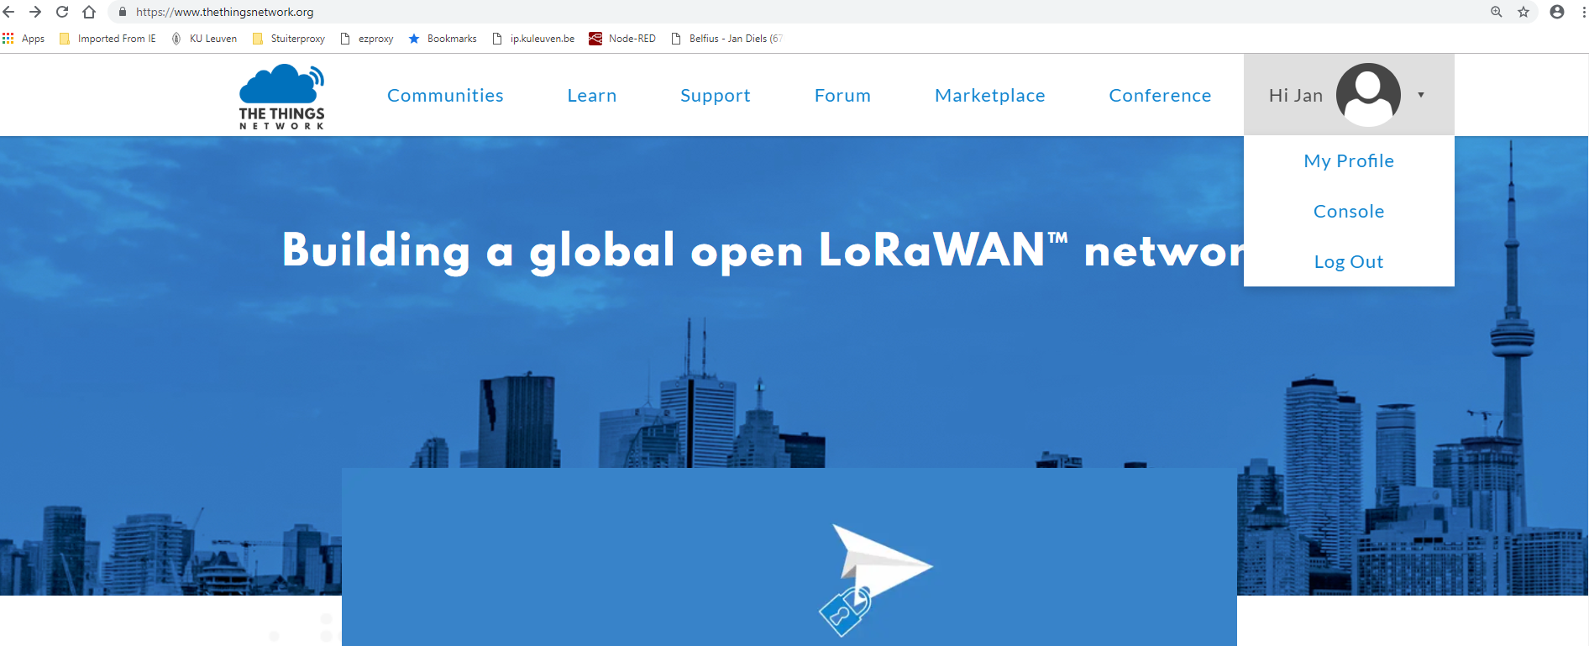
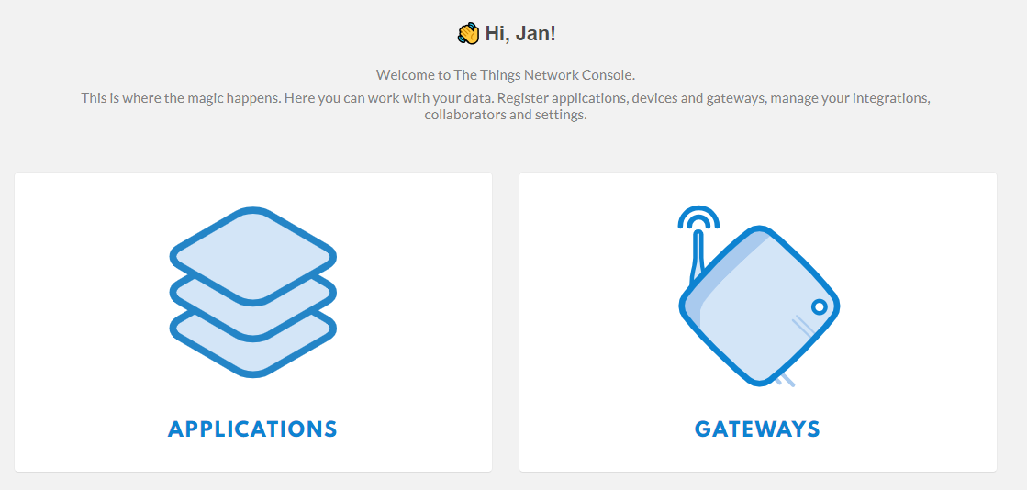
Registering your lopy4 as a device on The Things Network (TTN)
Step 3: Register an application on The Things Network
Open console
Next chose ‘Applications’

Slide 45
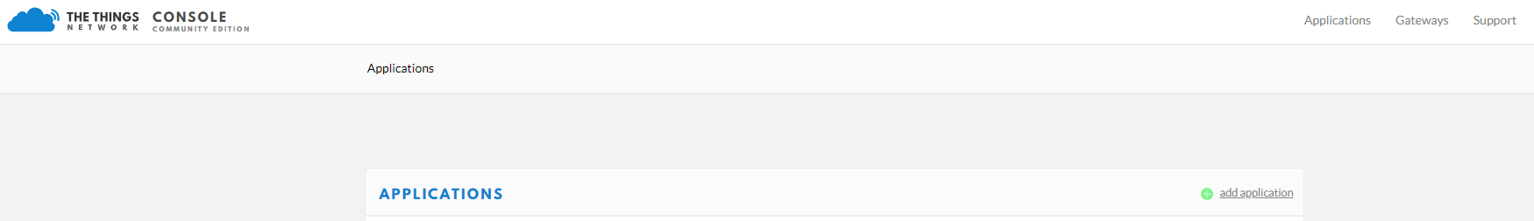
Registering your lopy4 as a device on The Things Network (TTN)
Step 3: Register an application on The Things Network
Add application

Slide 46
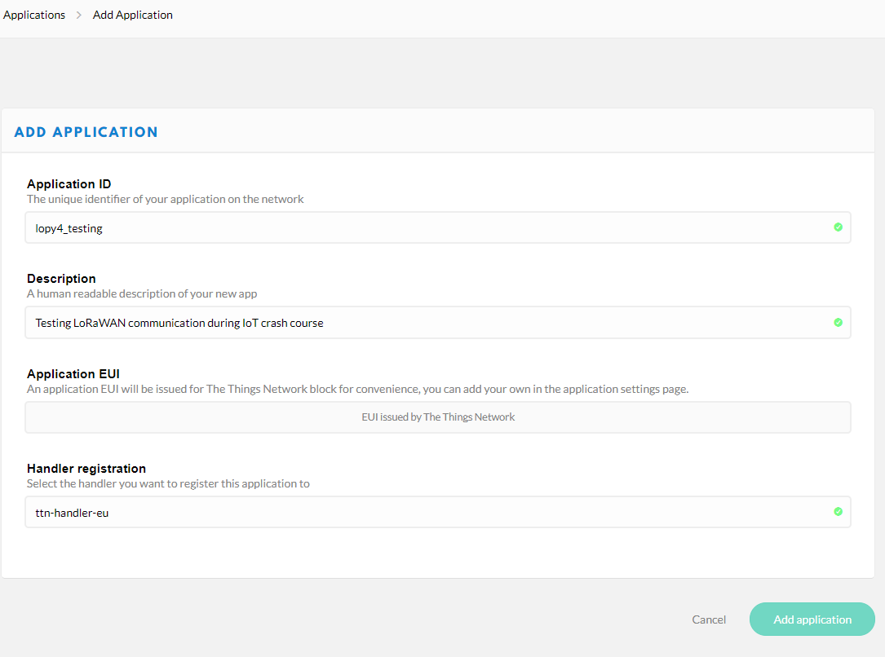
Registering your lopy4 as a device on The Things Network (TTN)
Step 3: Register an application on The Things Network
Chose an application ID (1 single word)
Add some description
Leave blank
Don’t change

Slide 47
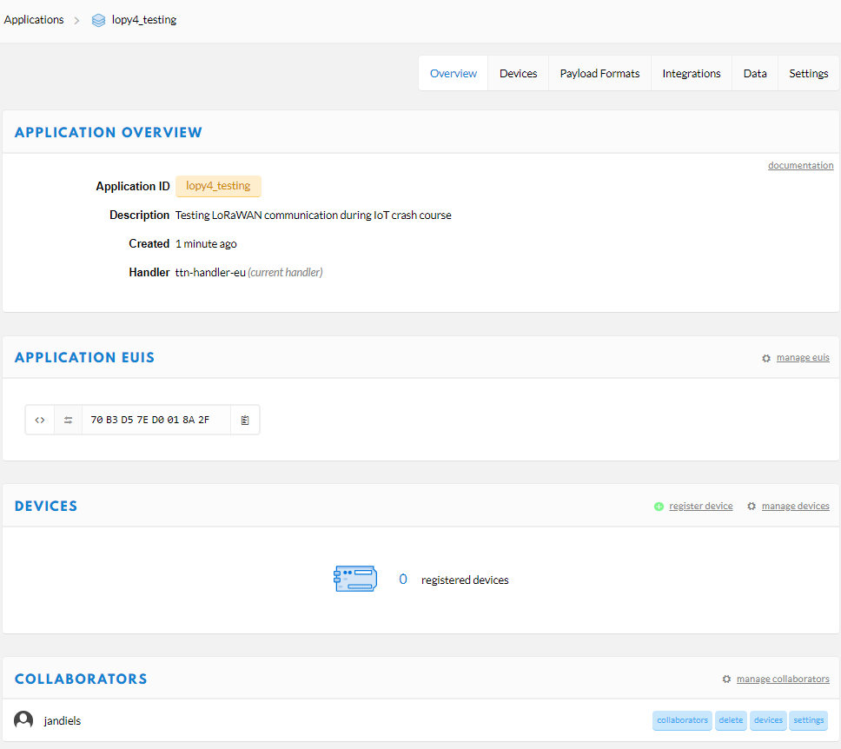
Registering your lopy4 as a device on The Things Network (TTN)
Step 3: Register your lopy4 as device on The Things Network
Now register your device (your lopy4)

Slide 48
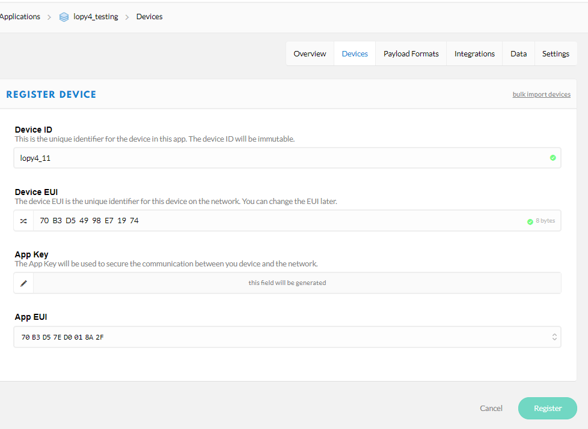
Registering your lopy4 as a device on The Things Network (TTN)
Step 3: Register your lopy4 as device on The Things Network
Chose a unique device ID (1 single word)
Copy DevEUI from Pymakr window

Slide 49
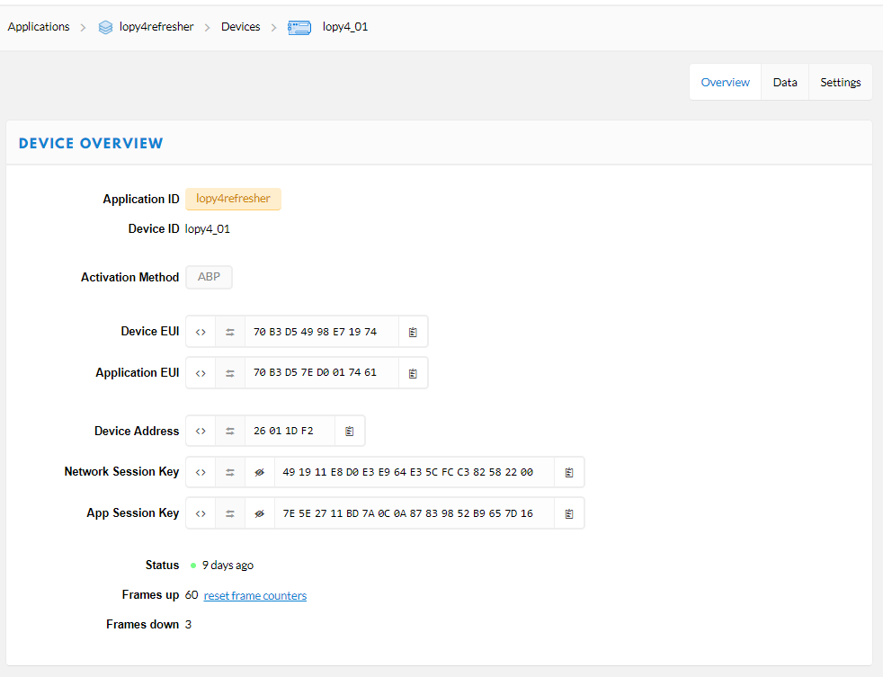
Registering your lopy4 as a device on The Things Network (TTN)
Step 4: Now copy Network Session Key and App Session Key from TTN to your micropython code
main.py in folder \IoT course\SendLora2TTN_abp
Chose ABP (Activation By Personalization)
Use ‘copy to clipboard’ button

Slide 50
main.py in folder \IoT course\SendLora2TTN_abp
(code was taken from Pycom website and adapted)
main.py in folder \IoT course\SendLora2TTN_abp
Creating payload
Sending payload
Blink green led if downlink received

Slide 51
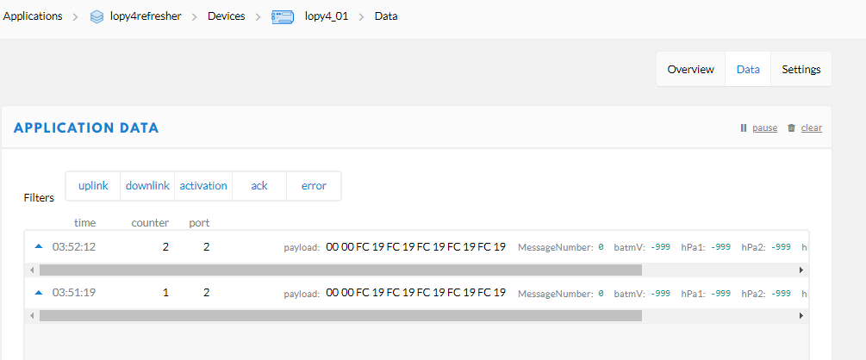
Callback function sends payload
User pushbutton triggers interrupt
Task 10:
(After saving file) Run main.py in folder \IoT course\SendLora2TTN_abp and check both the Pymakr console and the TTN website. Is any downlink received?

Slide 52
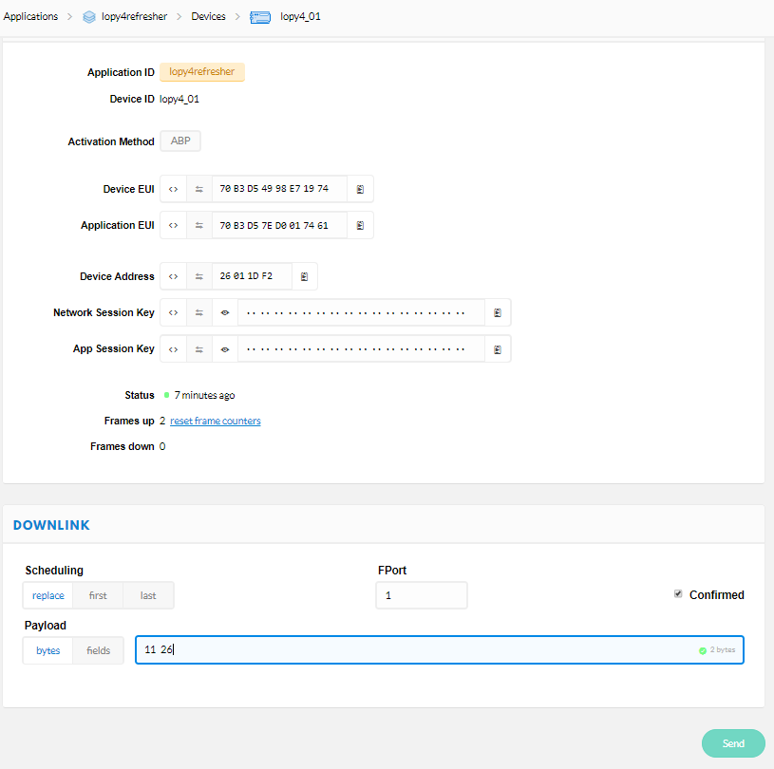
Send some nonsense data with downlink

Slide 53
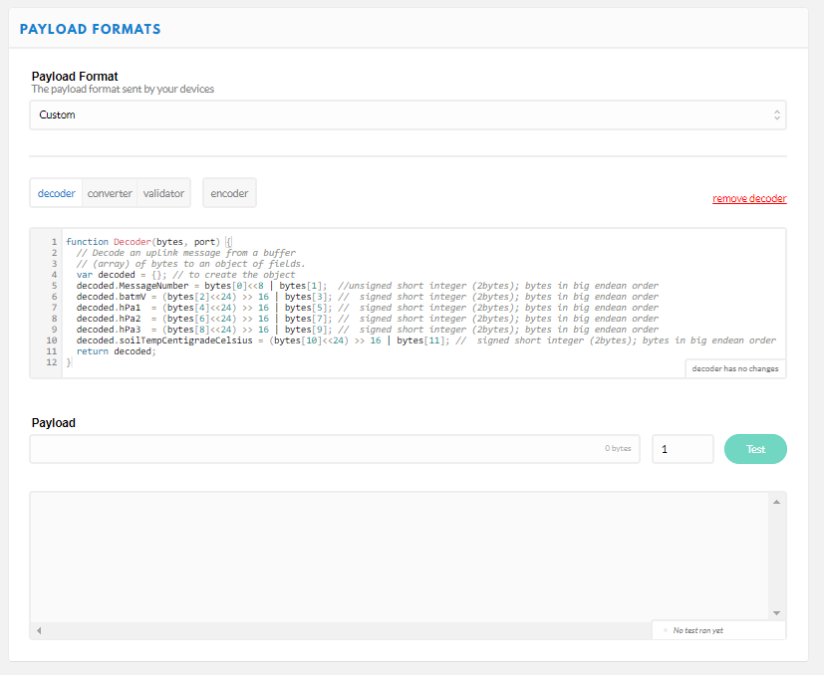
Registering your lopy4 as a device on The Things Network (TTN)
Step 5: Decoding the payload at TTN
JavaScript code
(\IoT course\SendLora2TTN_abp\decode.js"

Slide 54
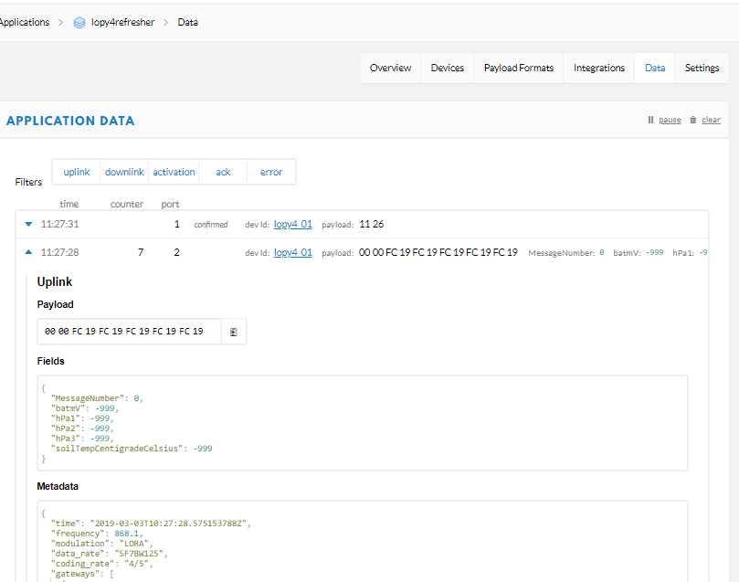
Double click on payload to show details below
Copy payload to clipboard
This only becomes visible after decoder function is active

Slide 55
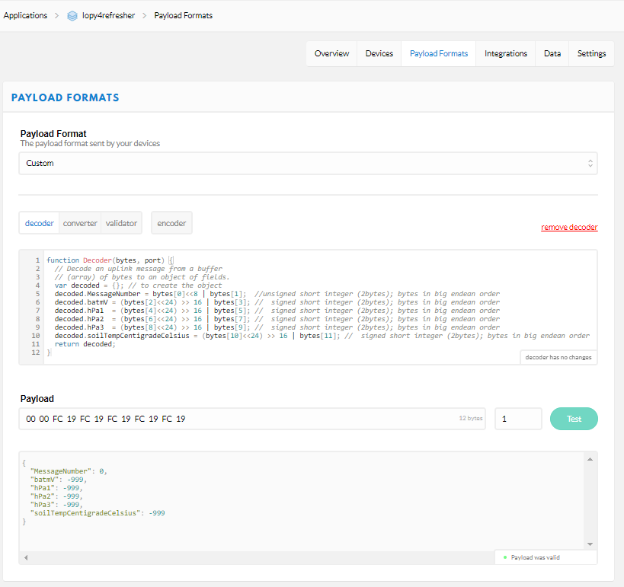
Registering your lopy4 as a device on The Things Network (TTN)
Step 5: Decoding the payload at TTN
JavaScript code
Paste payload there to test decoder
Test
Payload = array of bytes shown in dexadecimal format
Decoded payload

Slide 56
Bits and bytes
Bit (Binary digit) can have value of 0 or 1
Byte = 8 bits
Binary format: 00000000 to 11111111
(=base 2: values can be 0 or 1)
Decimal format: 000 to 255
(=base 10: values can be 0, 1, 2, …, 9)
Hexadecimal format: 00 to FF
(base 16: values can be 0, 1, 2, …, 9, A, B, … F)
LoRa and Sigfox payloads are send in binary format, but we will show it in hexadecimal format because it is compact

Slide 57
Encoding in micropython script
Decoding in decoder function at TTN
Bytes[0]
Bytes[1]

Slide 58
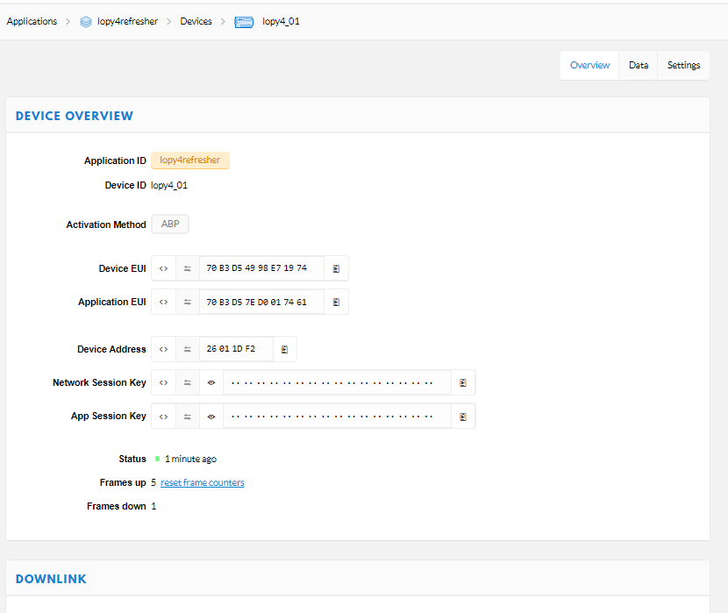
Troubleshooting: what to do if payload is not received at The Things Network
Common problem: When your node was restarted, you also need to reset the frame counters:

Slide 59
Data communication we will use:
Cloud services
HTTP via internet
LoRaWAN
Nano gateway with lopy4
HTTP via internet
Your lopy4
To reformat the data for ThingSpeak
Visualization, quality control, storage, analysis

Slide 60
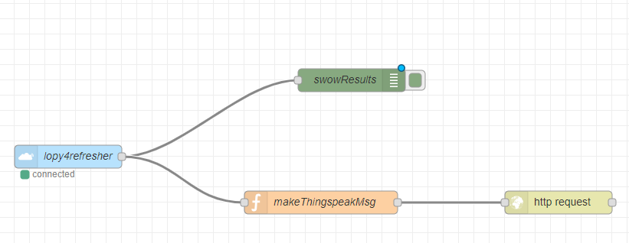
This node gets data from TTN
This node reformats the data for ThingSpeak
This node sends data to ThingSpeak in http format
More information: https://www.npmjs.com/package/node-red-contrib-ttn

Slide 61


Slide 62




IoT project I am working on:
Inexpensive device for monitoring soil moisture content in irrigated field
1 × antenna
3 × Watermark sensor (Irrometer Company)
1 × LoPy⁴ development board (µcontroller with LoRaWAN and Sigfox capability)
1 × LiPo battery 3.7V 2000mAh
1 × soil temperature sensor (DS18B20)
Notes:
Sensors about 150€, µProcessors and accessories about 100€ >>> Sensors are always more expensive (raingauge, pressure transducer, …)

Slide 63


It is best to also log the measured data on the lopy4 using an SD card (slot on expansion board)
Pycom provides library for accessing the SD card

Slide 64


With LoPy4 you get 1 year Sigfox connectivity included in price.
Present coverage: blue=covered; purple=country under roll-out

Slide 65
Useful links:
Two excellent explanation video’s about LoRaWAN, TTN, TTN gateway and TTN node: https://www.thethingsnetwork.org/community/berlin/post/lpwan-ttn-2-very-good-explanation-videos
Encoding and Decoding Payloads on The Things Network: https://core-electronics.com.au/tutorials/encoding-and-decoding-payloads-on-the-things-network.html
Explaining LoRaWAN: https://ubidots.com/blog/explaining-lorawan/
Slides lora-aliance: https://www.ietf.org/proceedings/96/slides/slides-96-lpwan-9.pptx

Slide 67



Costs of sensors in Belgium (VAT included)?
DS18B20 temperature sensor: 9.95€
Sonar MB7052 for water depth: 95.15€
Watermark sensor: 56€
Davis tipping-bucket raingauge
6463M : 131€
Solar radiation shield for temperature sensor (air temperature): 126€

